Slide 1
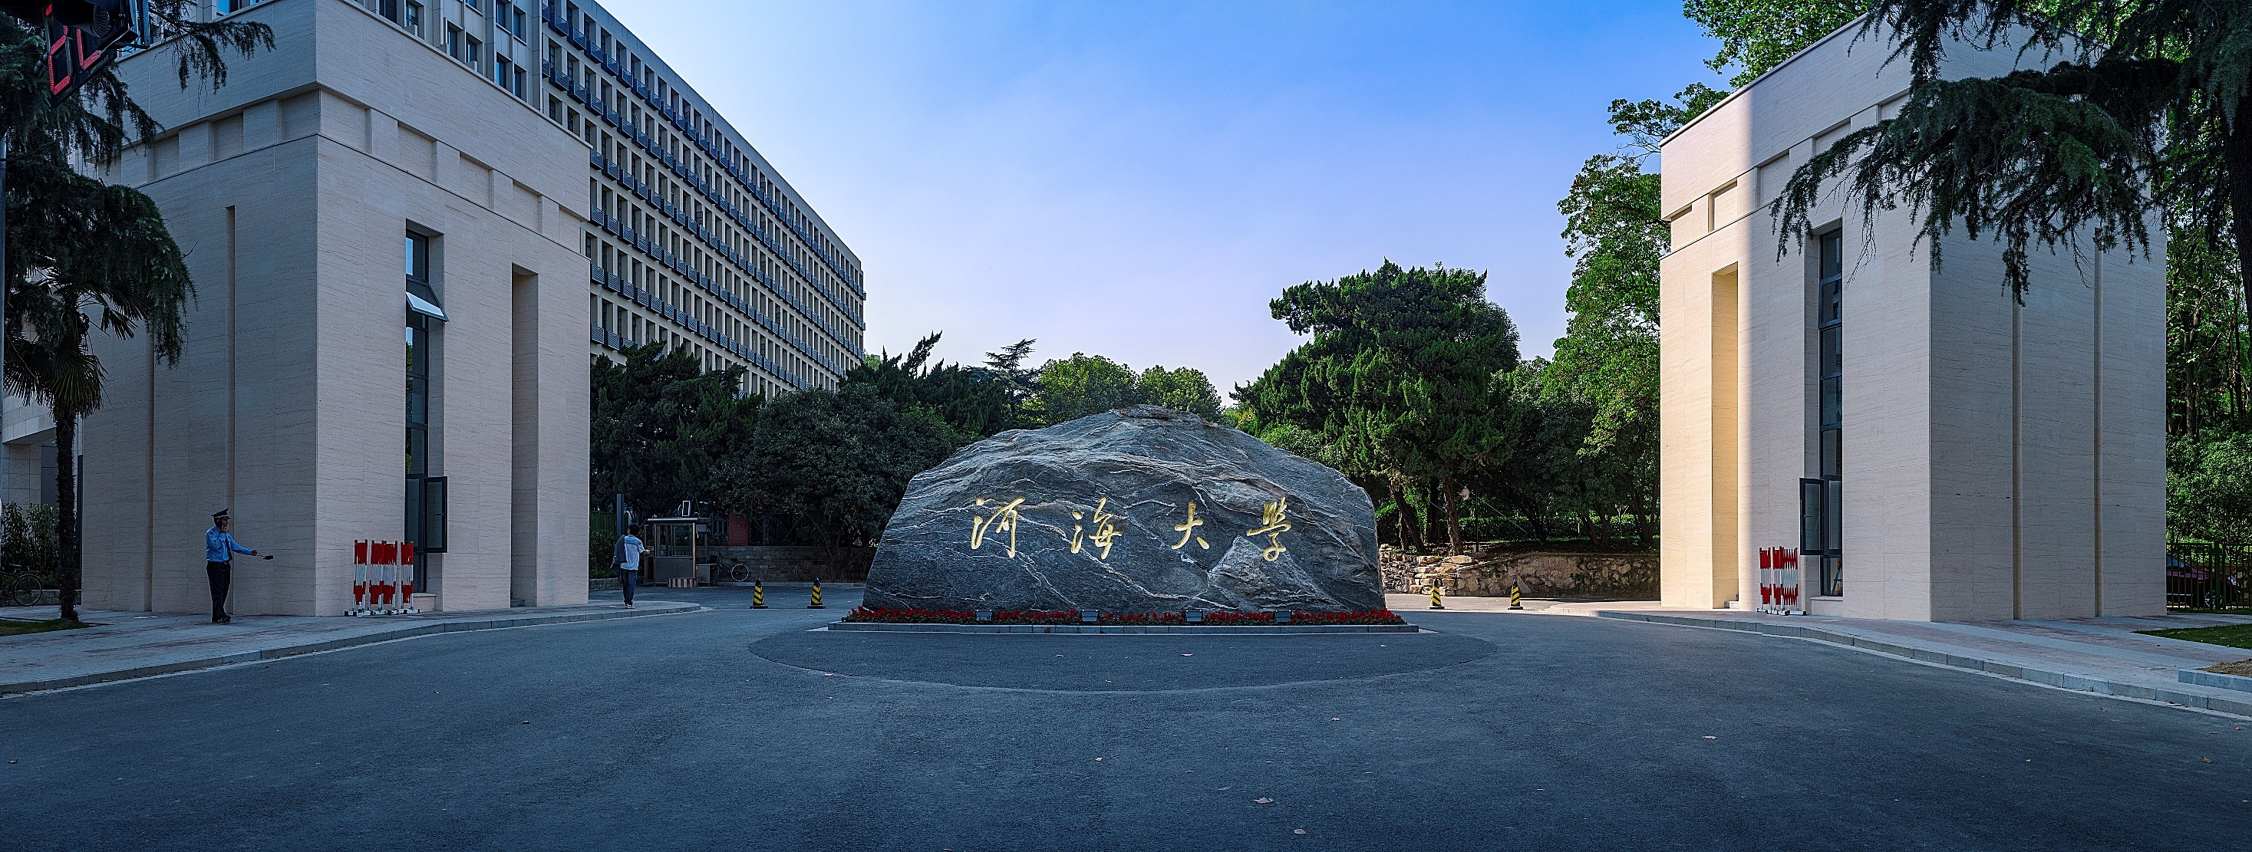


密集连接卷积网络
Densely Connected Convolutional Networks
汇报人：顾陈楠

Slide 2
论文：Densely Connected Convolutional Networks
来源：IEEE Conference on Computer Vision and Pattern Recognition（CVPR） 2017 Best Paper
作者：Gao Huang, Zhuang Liu, Laurens van der Maaten, Kilian Q. Weinberger

Slide 3


1
Introduction
2
Related Work
3
DenseNets
4
Experiments
文 章
目 录
CONTESTS
5
Discussion
6
Conclusion

Slide 4
Introduction
CNN的出现与发展
各类模型崭露头角。
新的研究问题开始出现： as information about the input or gradient passes through many layers, it can vanish and “wash out” by the time it reaches the end (or beginning) of the network
改进解决
共通之处：reate short paths from each layers to later layers.

Slide 5
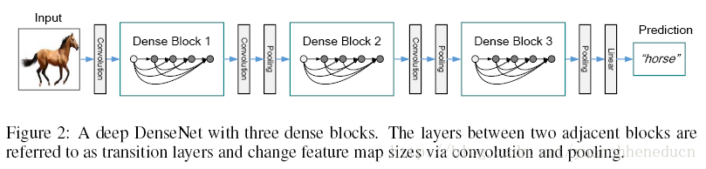
Motivation
想法来源：shorted connected
提出“稠密卷积网络dense convolutional network（DensNet）

Slide 6
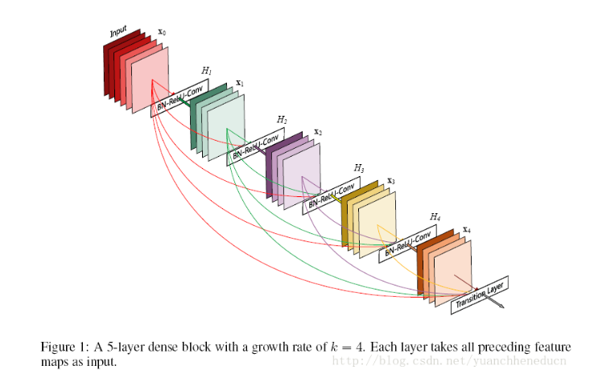
Dense Block
两个改进版本：
版本一：DenseNet-B：
BN-ReLU-Conv(1x1)-BN-ReLU-Conv(3x3)

Slide 7
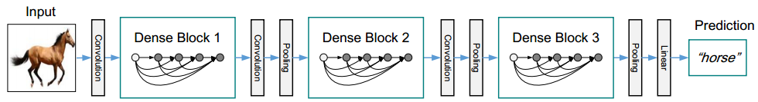
DenseNet
transition layer过渡层
版本二：DenseNet-BC：
在DenseNet-B的基础上，对过渡层的特征图进行压缩，产生⌊θm⌋个特征图，其中0<θ≤1，为压缩因子。

Slide 8
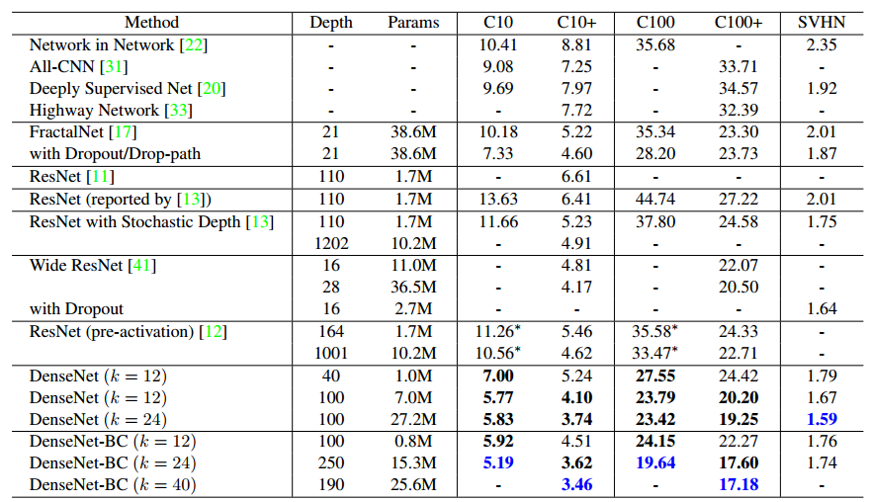
Experiments&Result
Datasets:CIFAR、SVHN、ImageNet

Slide 9
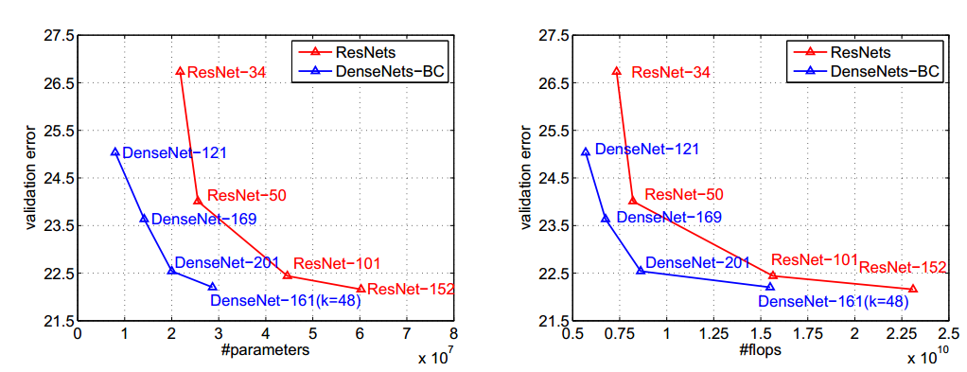
Experiments&Result

Slide 10
Contribution
Abstract：
DenseNets have several compelling advantages:
1、they alleviate the vanishing-gradient problem,
2、strengthen feature propagation,
3、encourage feature reuse,
4、and substantially reduce the number of parameters.
针对实验结果，作者从Accuracy, Capacity, Parameter effectiveness, Overfitting 四个方面进行说明。

Slide 11
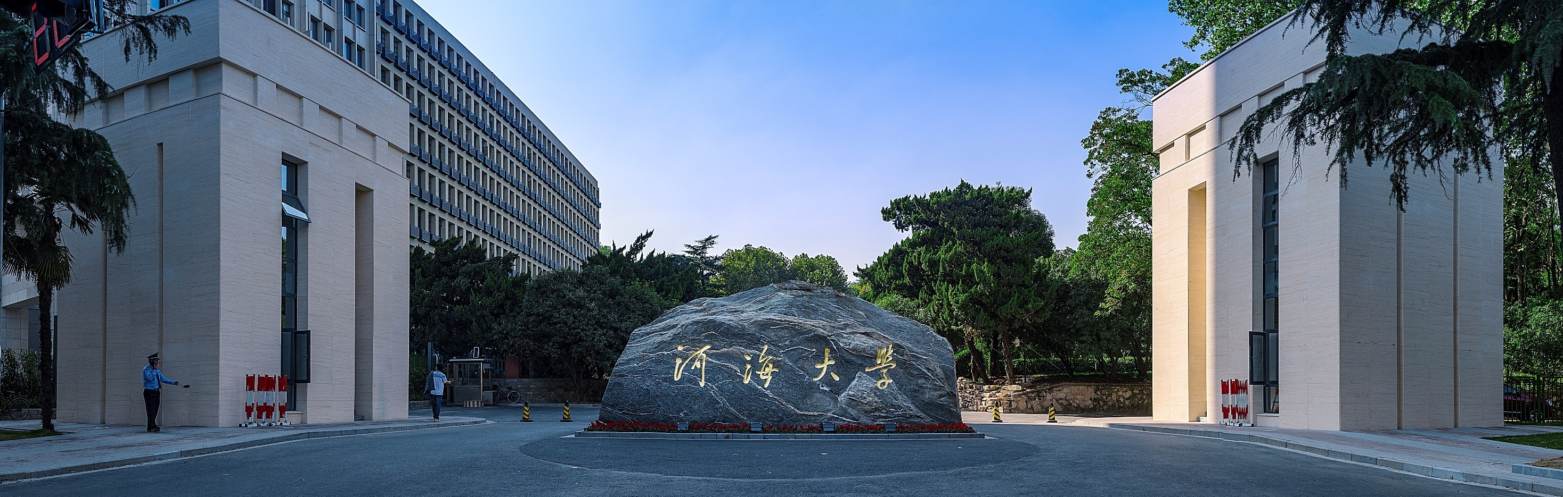
敬请老师、同学批评指正

